Slide 1
Link layer, LANs: outline
5.1 introduction, services
5.2 error detection, correction
5.3 multiple access protocols
5.4 LANs
addressing, ARP
Ethernet
switches
VLANS
5.5 link virtualization: MPLS
5.6 data center networking
5.7 a day in the life of a web request

Slide 2
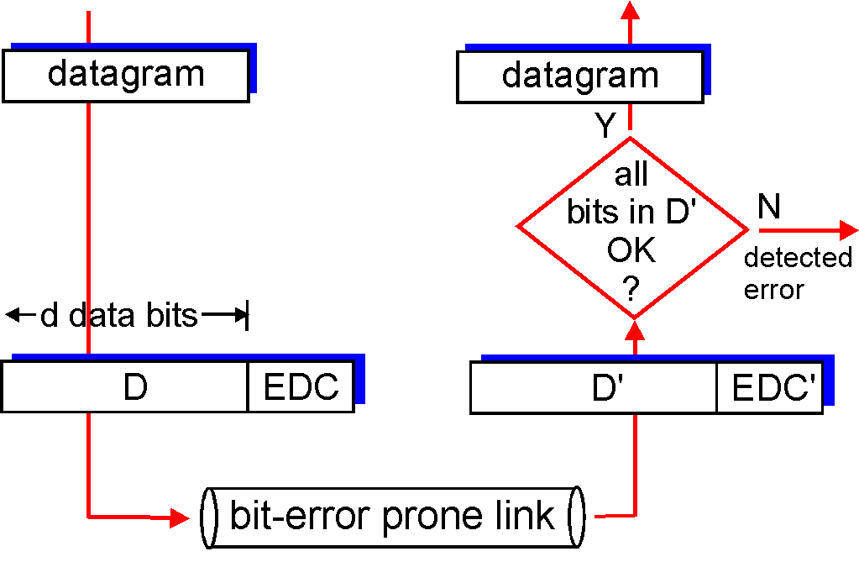
Error detection
EDC= Error Detection and Correction bits (redundancy)
D = Data protected by error checking, may include header fields
Error detection not 100% reliable!
protocol may miss some errors, but rarely
larger EDC field yields better detection and correction
otherwise

Slide 3
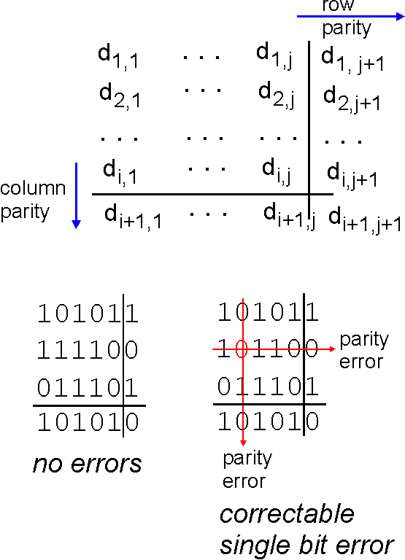
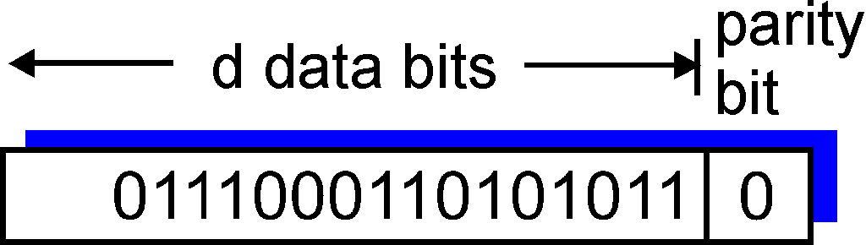
Parity checking
single bit parity:
detect single bit errors
two-dimensional bit parity:
detect and correct single bit errors
0
0

Slide 4
Internet checksum (review)
goal: detect “errors” (e.g., flipped bits) in transmitted packet (note: used at transport layer only)
sender:
treat segment contents as sequence of 16-bit integers
checksum: addition (1’s complement sum) of segment contents
sender puts checksum value into UDP checksum field
receiver:
compute checksum of received segment
check if computed checksum equals checksum field value:
NO - error detected
YES - no error detected. But maybe errors nonetheless?

Slide 5
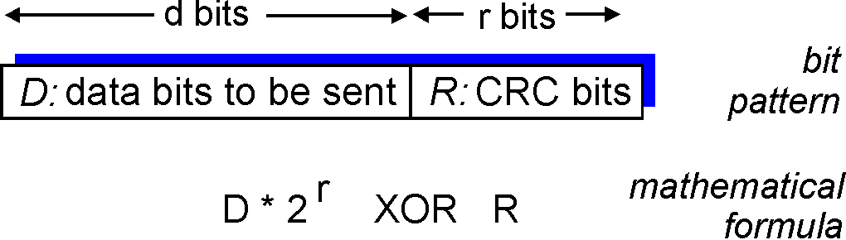
Cyclic redundancy check
more powerful error-detection coding
view data bits, D, as a binary number
choose r+1 bit pattern (generator), G
goal: choose r CRC bits, R, such that
<D,R> exactly divisible by G (modulo 2)
receiver knows G, divides <D,R> by G. If non-zero remainder: error detected!
can detect all burst errors less than r+1 bits
widely used in practice (Ethernet, 802.11 WiFi, ATM)

Slide 6
CRC example
want:
D.2^{r} XOR R = nG
equivalently:
D.2^{r} = nG XOR R
equivalently:
if we divide D.2^{r} by G, want remainder R to satisfy:
G
D
r = 3
1
01000
1001
101110000
1001
101
000
1010
1001
010
000
100
D.2^{r}
G
000
R = remainder[ ]
R
1000
0000
1000

